Slide 1
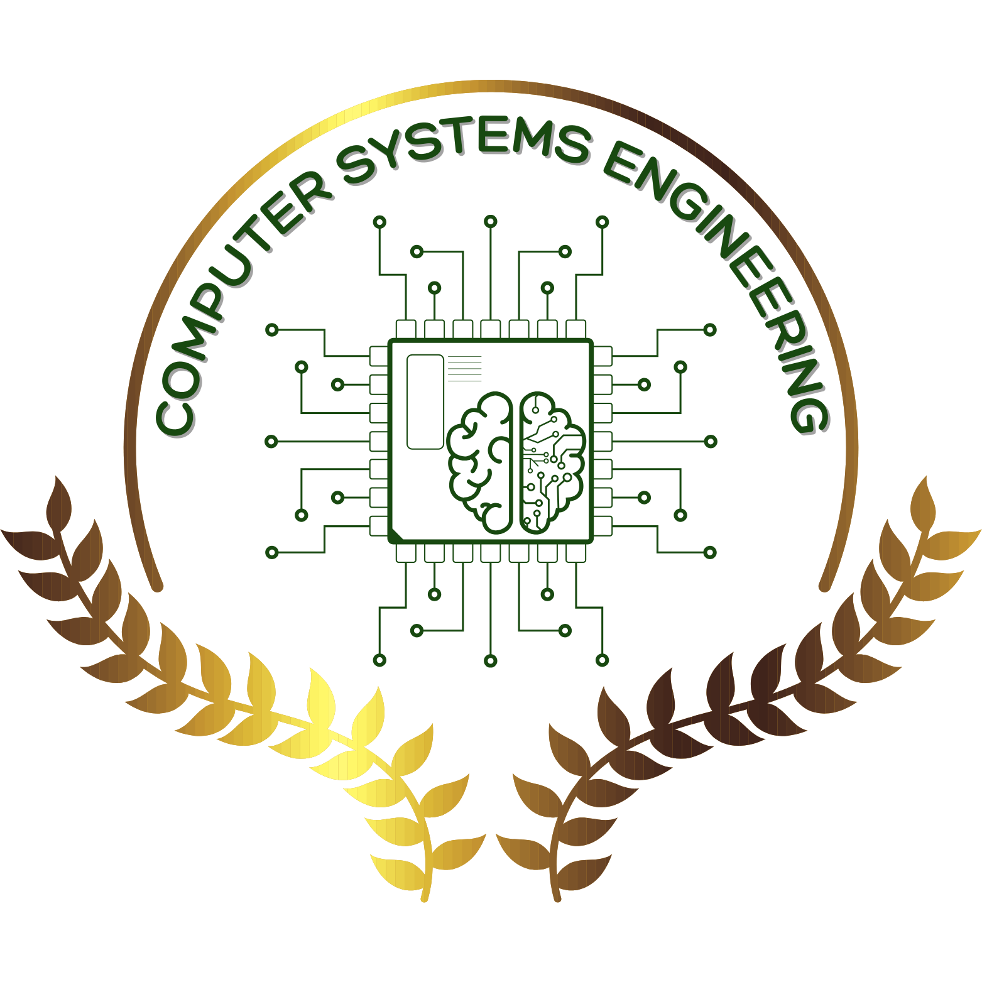
Diary Management System
Student Names: Jana Mohamed Alaa 242319
Eyad Karam Okasha 241539
Omar Ayman 240033
Ahmed sameh 240351

Slide 2
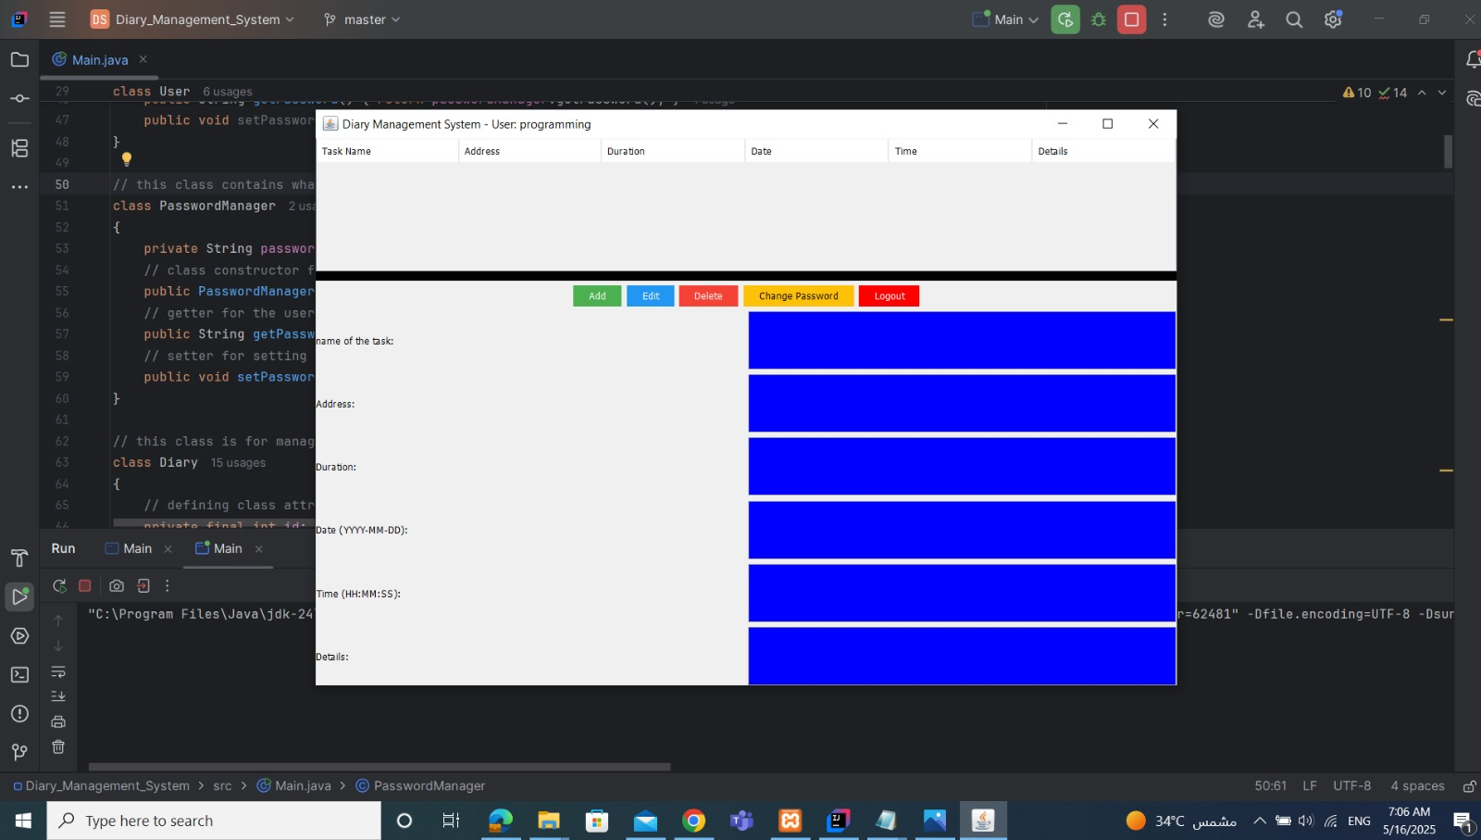
Diary management system (Java Project)
A desktop application that manages personal diary entries, where users can create content and titles and organize them by date.
Built using Java programming language
Includes database storage and a graphical user interface

Slide 3
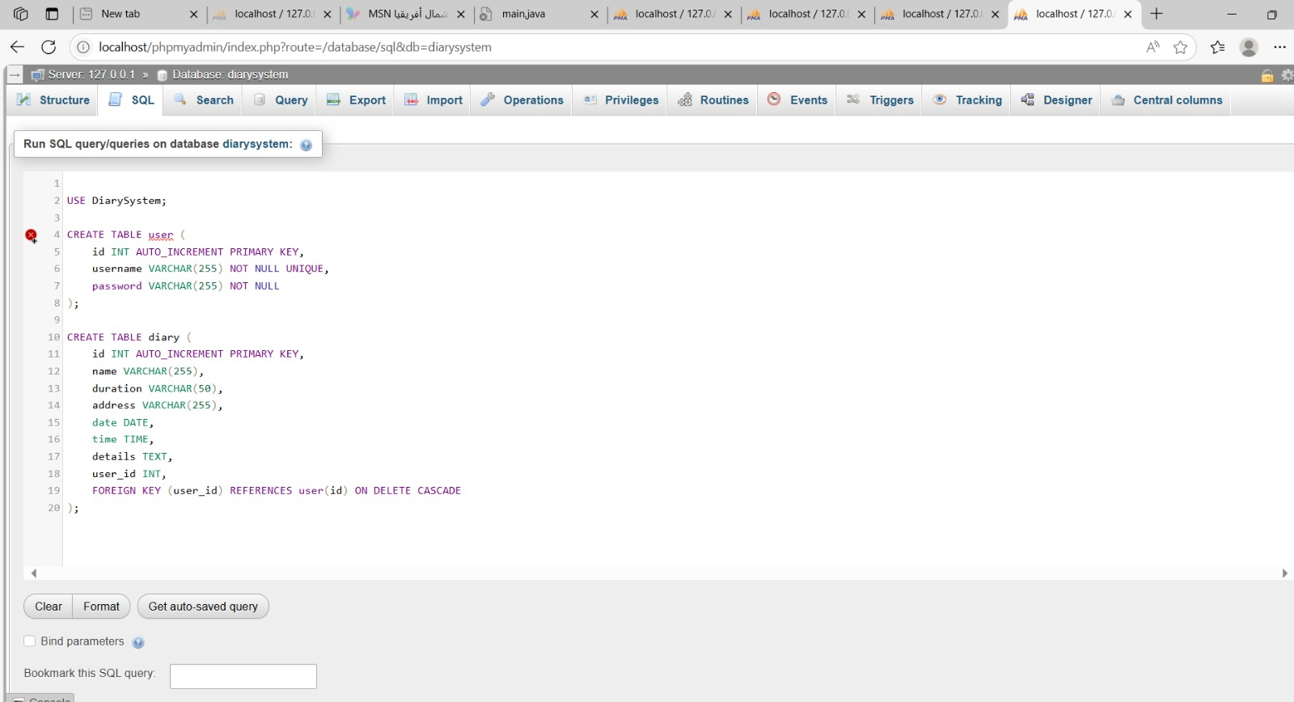
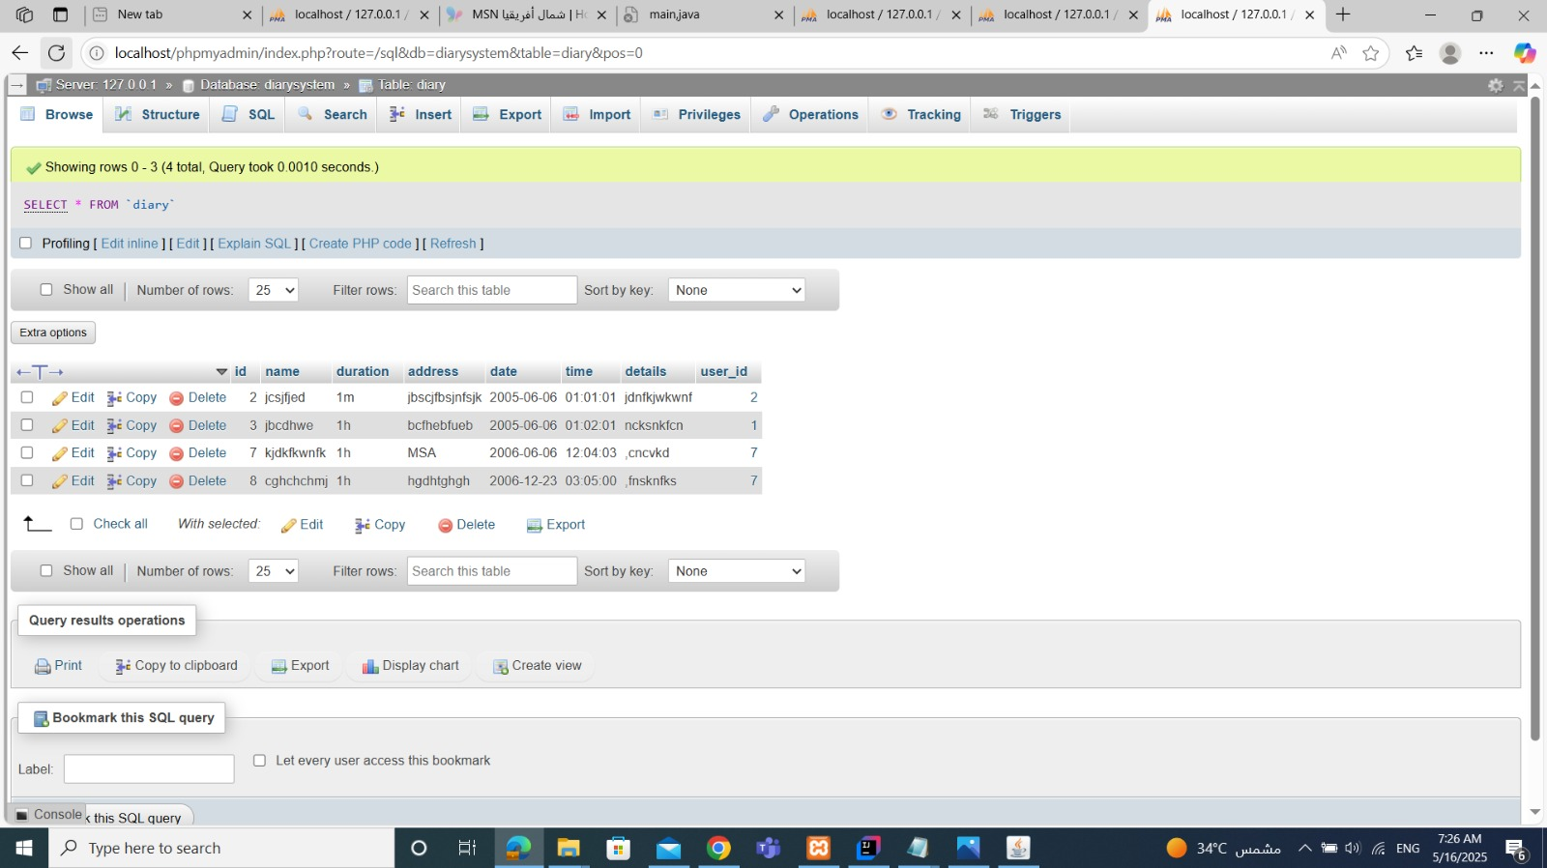
Connection to the database
The diary management app connects to a MySQL database.
It stores and retrieves diary data from it.
It employs a common connection approach to ensure reusability.

Slide 4
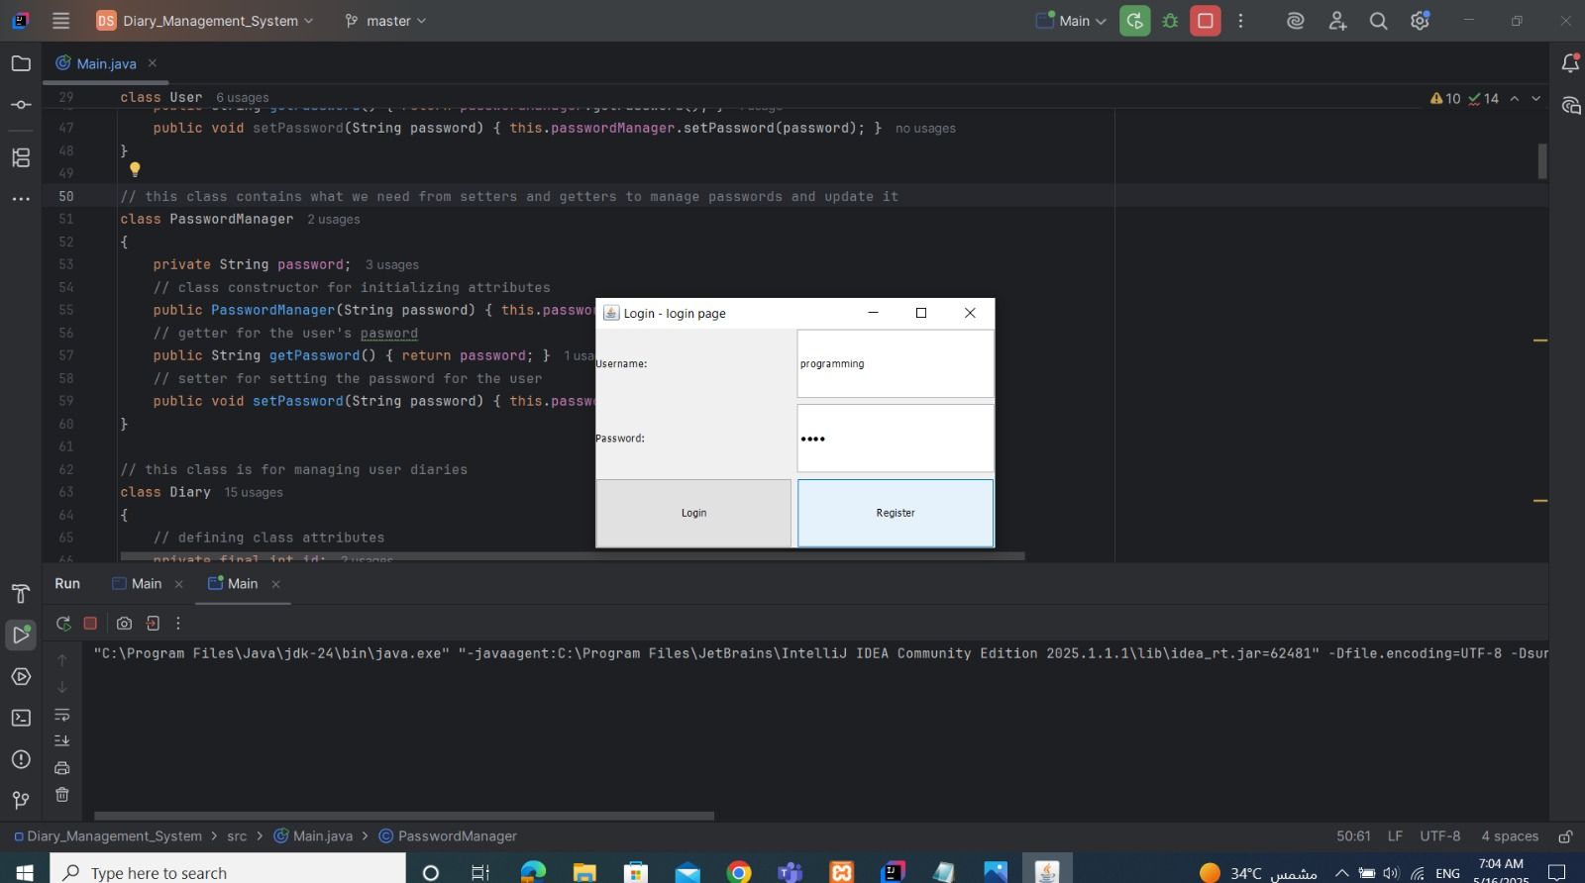
Login manager
Security & privacy: protects diary entries by ensuring only authorized users can access and manage their personal data.
User-specific access: Enables multiple users to have their own separate, personalized diaries within the same.
Data integrity: Prevents unauthorized access or accidental modifications by segregating each user’s data.

Slide 5
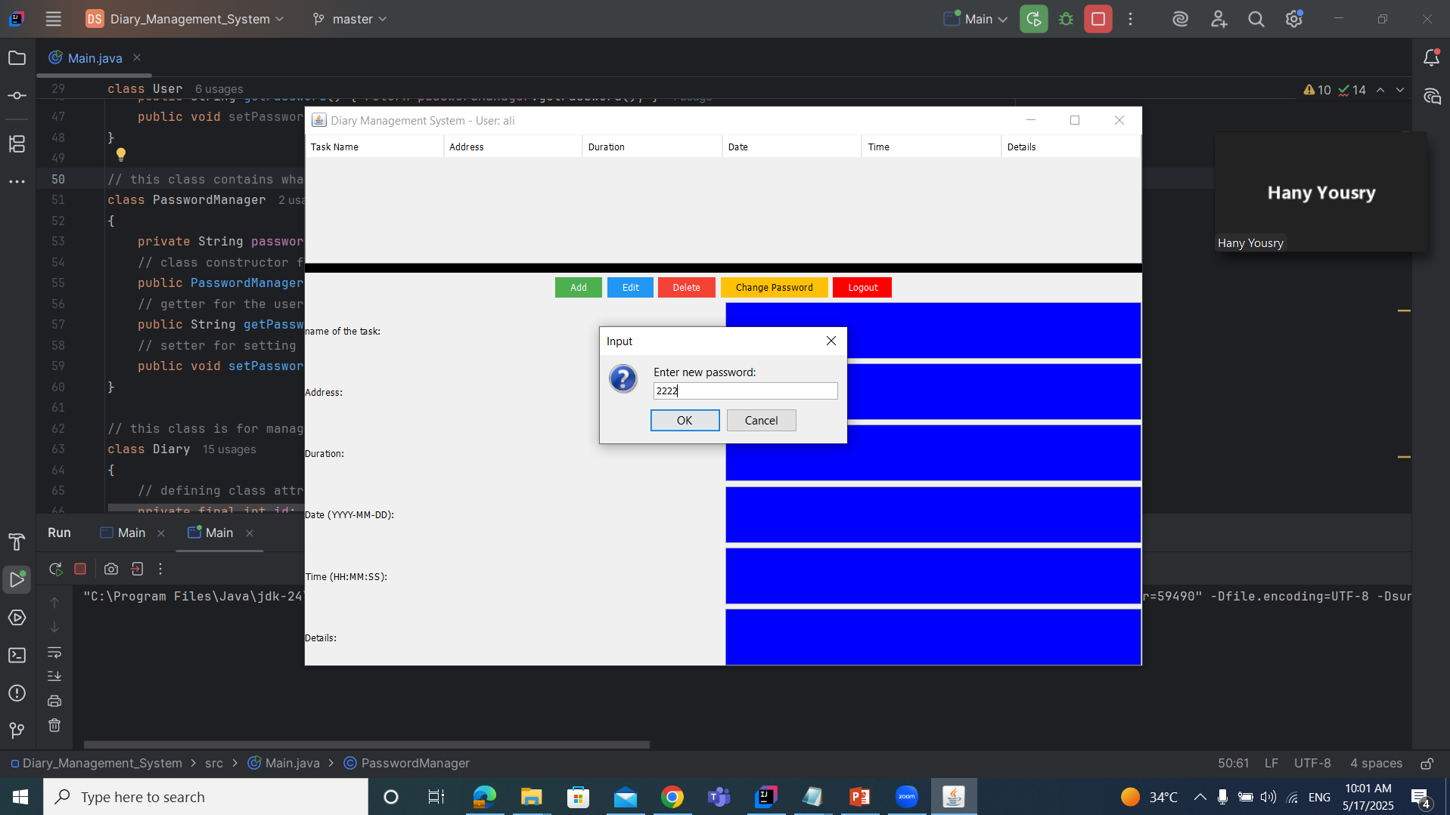
Password management
It allows the user to store and change their accounts’ password securely and easily.
It eliminates the need to remember multiple passwords.
This part is done in a separate part of the code.

Slide 6
Creating the user interface
App interface is the part of the app that the user interacts with. That includes menus, tables, text fields and buttons
Everything appears in one main application window, ensuring easier access.
Interface was created using Java Swing (GUI toolkit).

Slide 7

Making the app interactive
App interactivity is how the users engage or control the app, meaning that It includes the actions that a user can take, like tapping, swiping or clicking.
Clicking on a diary entry loads it for editing or deleting.
This improves the user experience and ensures a more user-friendly interface.

Slide 8

Add, View, Edit, Delete Entries
The “Add” feature allows the user to create a new diary entry.
The “View” feature shows a list of all the saved diary entries.
The “Edit” feature allows the user to modify an existing entry, or edit its title.
The “Delete” feature allows the user to remove a diary entry permanently.

Slide 9
Well structured and maintainable design
The code is split into 3 different parts (database, UI, logic), Each part has its own responsibility, which Makes the program easier to understand and update.

Slide 10
Summary
This project is a desktop-based Diary Management System developed in Java, designed to help users efficiently create, organize, and manage personal diary entries.
The system integrates a graphical user interface (GUI) built with Java Swing, and connects to a MySQL database for reliable data storage and retrieval.
The codebase is cleanly separated into three main layers: database operations, user interface, and business logic. This separation makes the app easier to maintain, understand, and scale.

